Slide 1

Module 2- Big Data Infrastructure
Hadoop Ecosystem- HBase

Slide 2

Hadoop Ecosystem
Why Hadoop can’t make a database?
“Unfortunately Hadoop makes a very
Poor database”

Slide 3
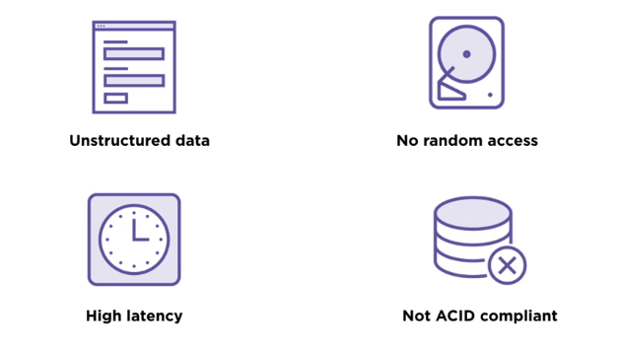
Hadoop Ecosystem
Limitations of Hadoop

Slide 4
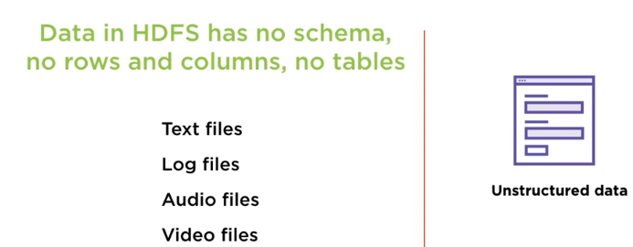
Hadoop Ecosystem
What is Unstructured Data?

Slide 5
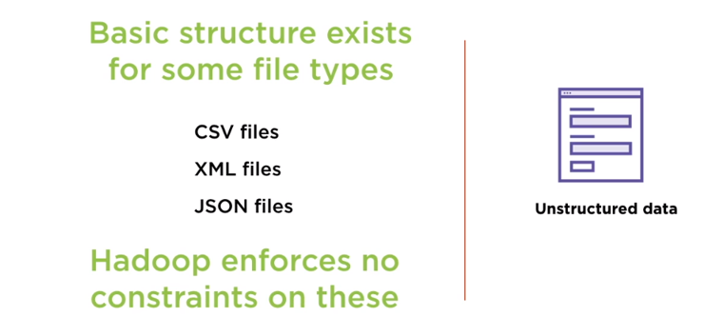
Hadoop Ecosystem
Why Hadoop is Unstructured?

Slide 6
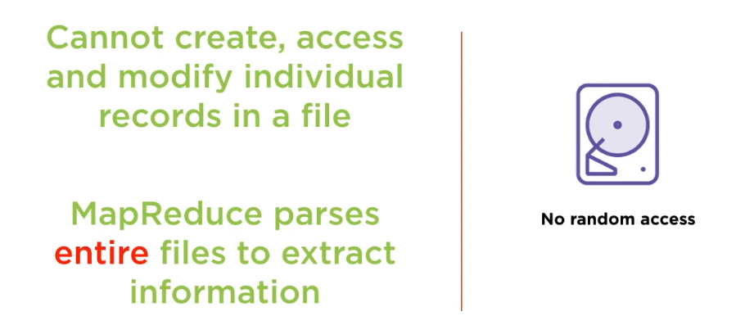
Hadoop Ecosystem
Why is Hadoop is non-random access?

Slide 7
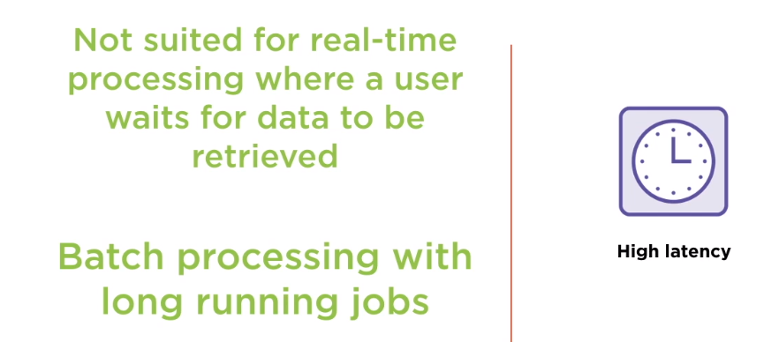
Hadoop Ecosystem
Why Hadoop has High Latency?

Slide 8
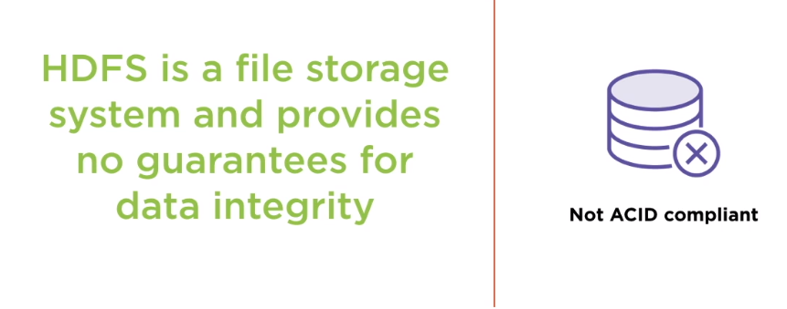
Hadoop Ecosystem
Why Hadoop is not Acid Complaint?

Slide 9
Hadoop Ecosystem
Why HBASE?
Consider that we have got a CSV file stored on HDFS and we need to query from it.
We would need to write a Java code for this, which wouldn't be a good option.
It would be better if we could specify the data key and fetch the data from that file.
So, what we can do here is create a schema or table with the same structure of CSV file to store the data of the CSV file in the HBase table and query using HBase APIs, or HBase shell using key.

Slide 10
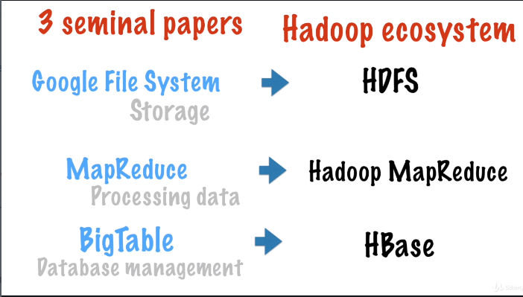
Hadoop Ecosystem
Idea again emerges from Google

Slide 11
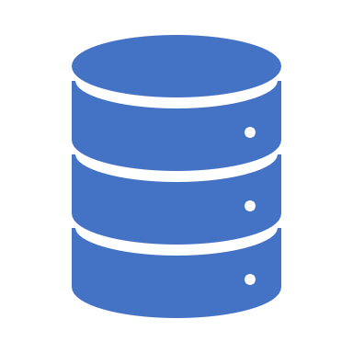
Hadoop Ecosystem
Why Hbase?
HBase is an open source, distributed, versioned, nonrelational database modelled after Google’s Bigtable.
Like Bigtable, HBase leverages the distributed data storage provided by the underlying distributed file systems spread across commodity servers.
Apache HBase provides Bigtable-like capabilities on top of Hadoop and HDFS.

Slide 12
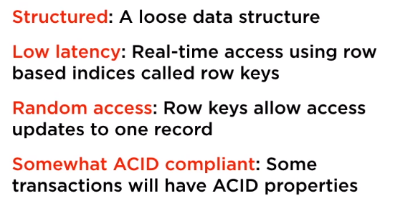
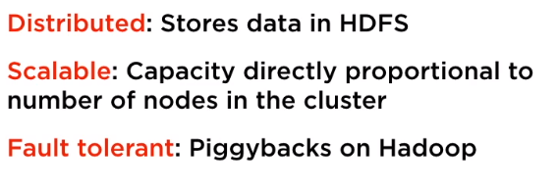
Hadoop Ecosystem
Features of HBase

Slide 13
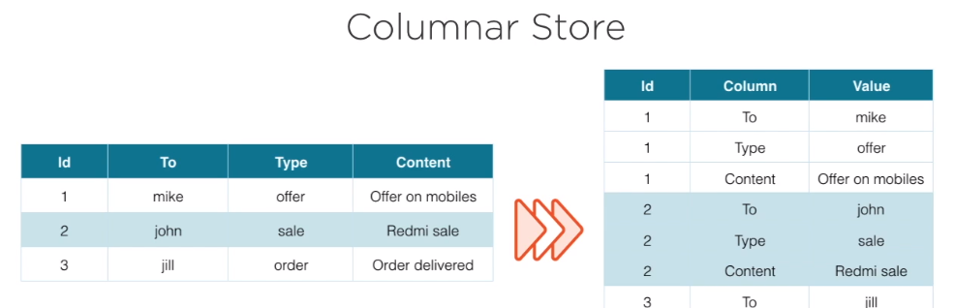
Hadoop Ecosystem
Hbase Vs Relational Database

Slide 14
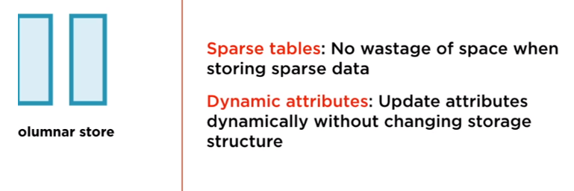
Hadoop Ecosystem
Advantages of columnar store

Slide 15
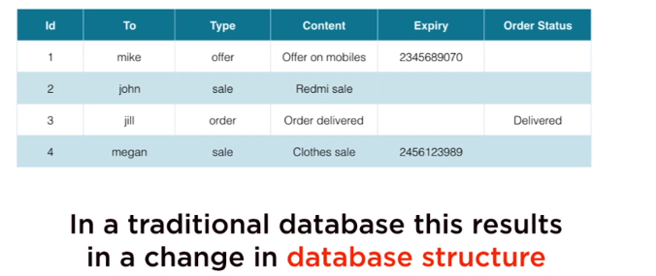
Hadoop Ecosystem
Sparse Tables

Slide 16
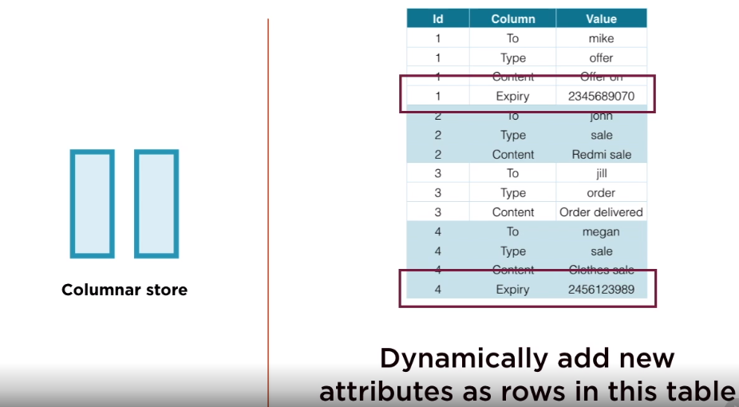
Hadoop Ecosystem
Dynamic Attributes

Slide 17
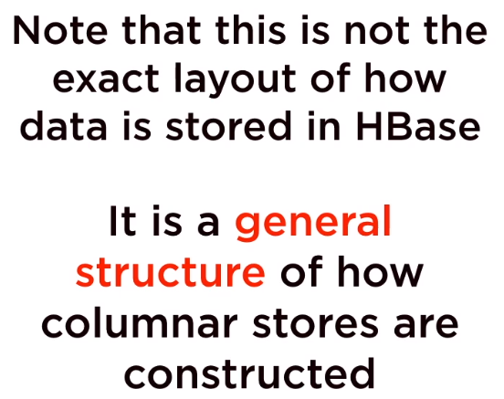
Hadoop Ecosystem
Hbase Structure

Slide 18
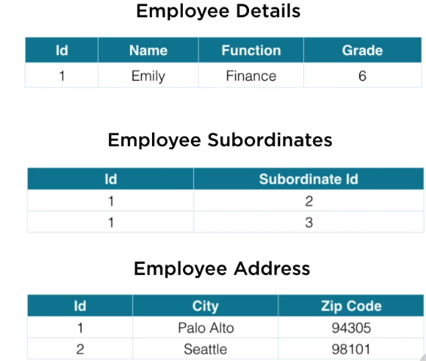
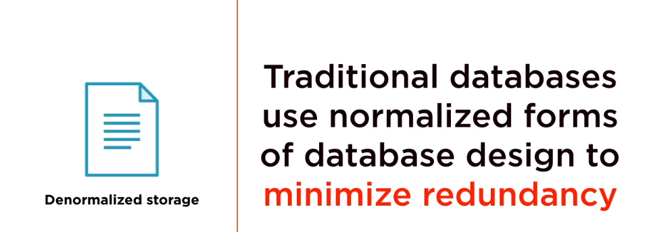
Hadoop Ecosystem
Denormalized Storage

Slide 19
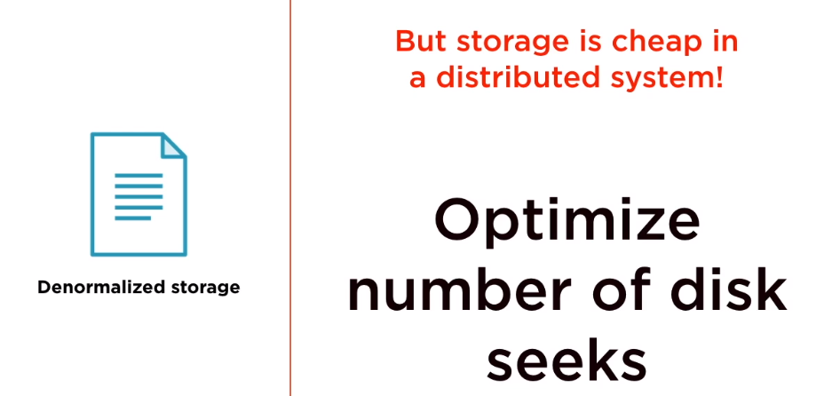
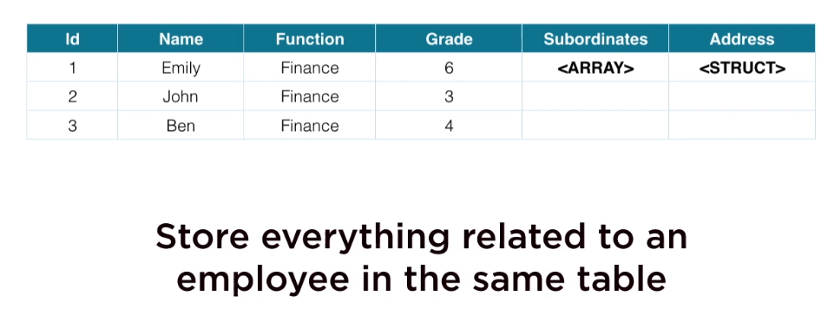
Hadoop Ecosystem
Number of Disk seeks

Slide 20
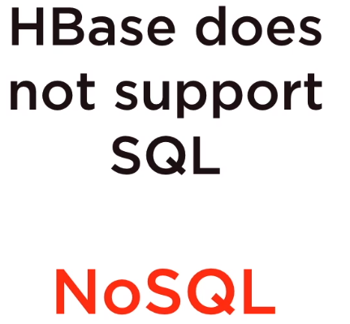
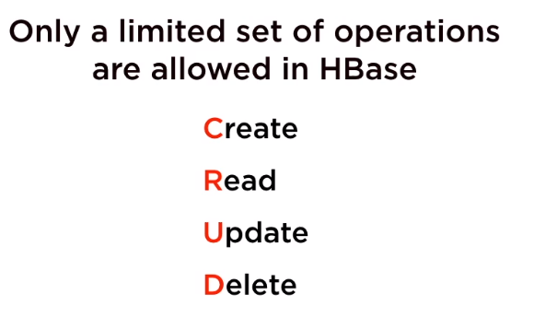
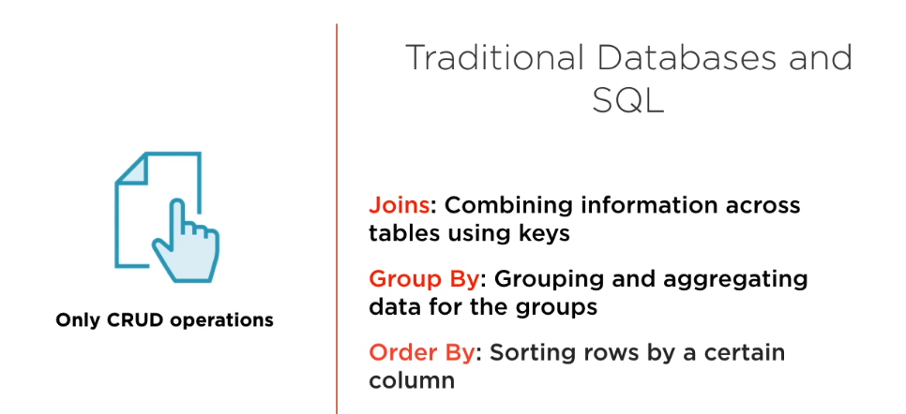
Hadoop Ecosystem
What is Hbase?

Slide 21
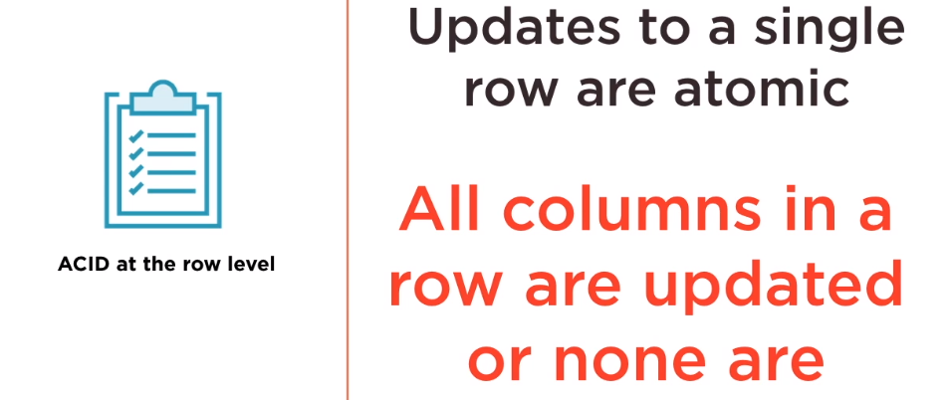
Hadoop Ecosystem
Maintaining ACID

Slide 22
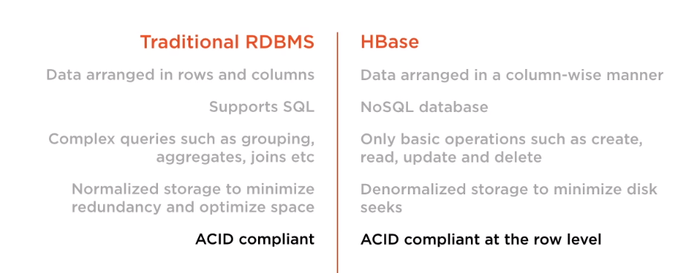
Hadoop Ecosystem
Differences between RDBMS and HBase

Slide 23
THANK YOU
“WORLD IS ONE BIG DATA PROBLEM”
“TORTURE THE DATA AND IT WILL CONFESS TO ANYTHING”

